Slide 1
Team106online
Sprint 8

Slide 2
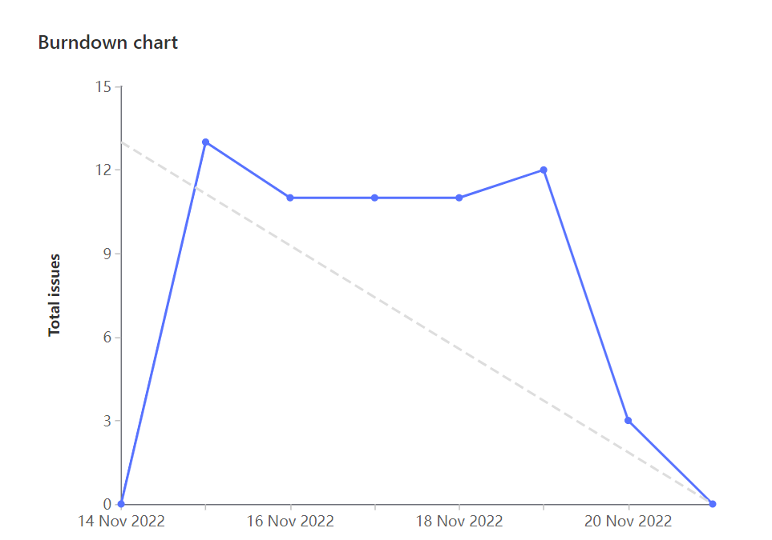
Sprint Progress

Slide 3
What Went Well
What To be Done Differently
Good pair programming sessions
Adding support for W23 term was simple thanks to the established DB
Team communication
More notifying when work has been completed
Make sure merges are done when issue is done

Slide 4
Team Member: Caleb Beere
Work Highlights:
Total Weights: 21
Refactored calendar page to use CSS grid
Created About Us page with Parker
Updated Wiki and README

Slide 5
Team Member: Parker Carnegie
Work Highlights:
Total Weights: 21
Researched exporting calendar to .ics file
Pair programmed with Caleb to Clean up UI components and create About Us page
Updated WIki and README

Slide 6
Team Member: Ivan Odiel Magtangob
Work Highlights:
Total Weights: 21
Created Selenium tests with Rehan and Mohammed
Researched Selenium
Updated documentation (README/Wiki)

Slide 7
Team Member: Rehan Nagoor
Work Highlights:
Total Weights: 21
Researched selenium testing
Created Selenium tests with Ivan and Salmaan
Updated documentation for the selenium testing with Ivan

Slide 8
Team Member: Hyrum Nantais
Work Highlights:
Total Weights: 21
Update database to include W23 data with Sam
Researched and setup selenium CI job
Added 404 routing to site

Slide 9
Team Member: Samuel Guilbeault
Work Highlights:
Total Weights: 23
Updated database schema, course parser, and db seeding job for W23 courses w/ Hyrum
Front- and back-end changes to support multi-term functionality
Support use of Prettier formatting extension

Slide 10
Team Member: Muhammad Salmaan
Work Highlights:
Total Weights: 22
Researched selenium and learned the new updated version
Worked on selenium testing script for front-end for all the functionalities with Rehan and Ivan
Fixed python listing errors along with Ivan and others

Slide 11
Team Member: Alif Merchant
Work Highlights:
Total Weights: 20
Improved visuals for course Schedule
Fix python ignored python lint errors
Researched .ics

Slide 12

Demo time!

